Slide 1

Polymer Physics: Theory & Simulation
Angelo Rosa
SISSA-Trieste, June 2019
Email: anrosa@sissa.it

Slide 2
Outline
Part I - Introduction to Polymers
Part II - Polymer Physics
Structure
Dynamics
Part III - Simulations methods:
Exact enumeration
Monte Carlo
Molecular Dynamics

Slide 3
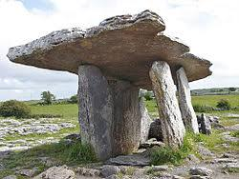
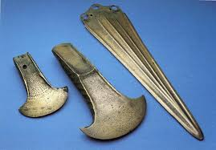
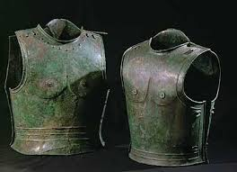
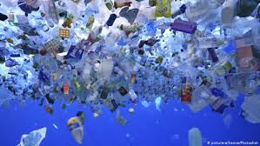
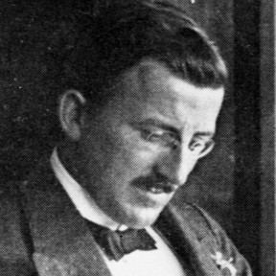
History of Polymer Science
Materials: Stone Bronze Iron Plastics
Macromolecular synthesis from the middle of the 19th century
Macromolecular hypothesis (1920’s), H. Staudinger (Nobel Prize Chem., 1953)
U. W. Suter, Why Was the Macromolecular Hypothesis Such a Big Deal?
Adv. Polym. Sci. 261, 61 (2013)
Definition:
Polymers (from Greek, poly=“many” + meros=“parts”) are chain molecules consisting of 10²-10⁹ monomeric units joined together by chemical reaction
Statistical polymer physics:
Basic ideas (1930-60): Kuhn, Flory, Huggins, Stockmayer, James, Guth, Zimm, Rouse
Correlations / entanglements (1960-90): Edwards, de Gennes, des Cloizeaux

Slide 4
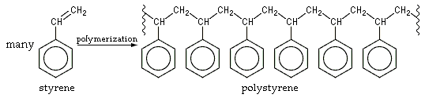
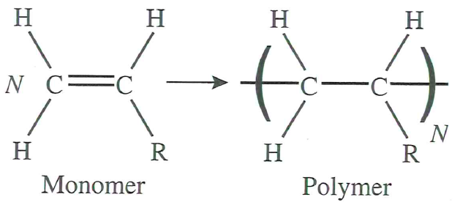
Chain reaction
Polymerization, process of covalent bonding of elementary units:
R = H => Polyethylene
R = Cl => Polyvinylchloride (PVC)
R = Benzene => Polystyrene

Slide 5
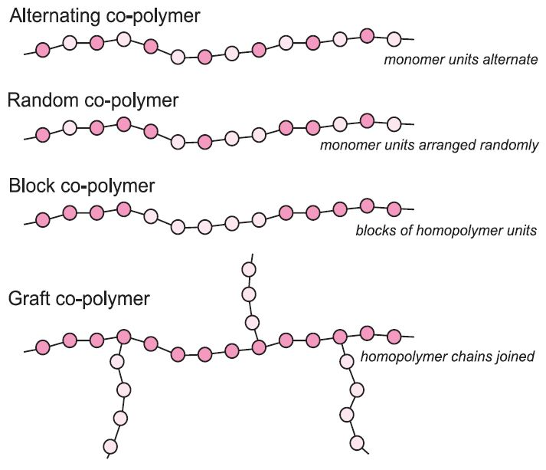
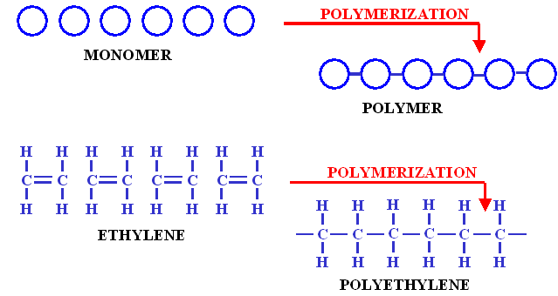
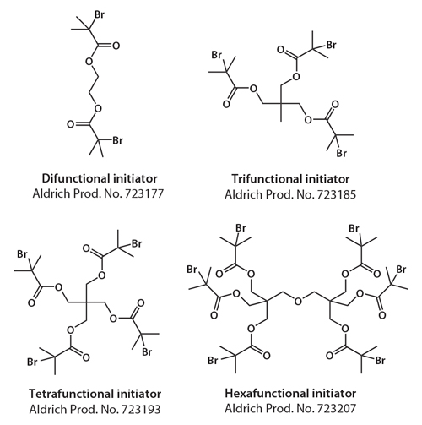
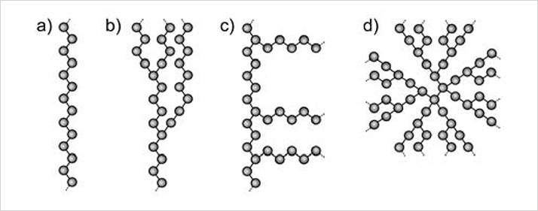
Polymer architectures

Slide 6
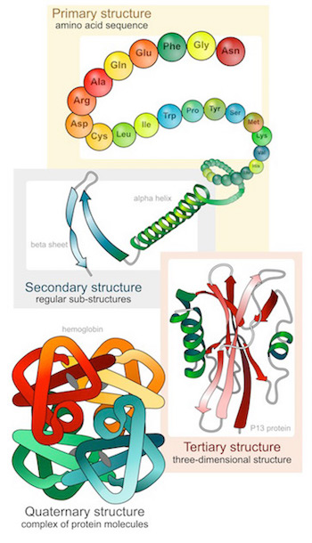
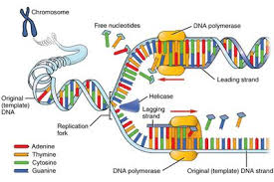
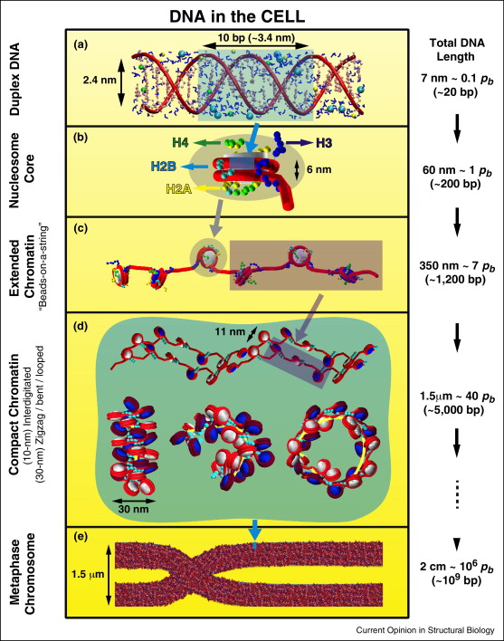
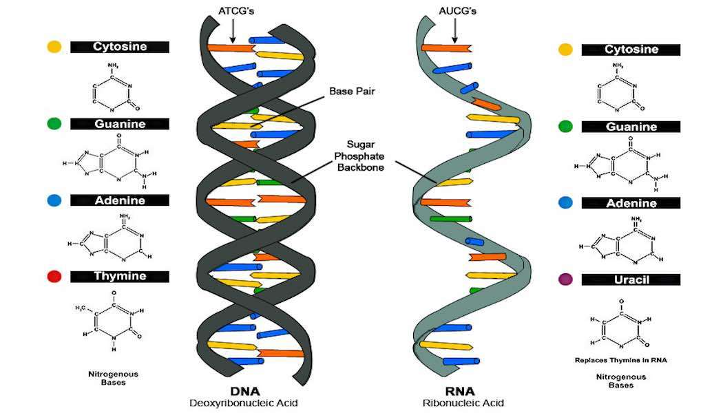
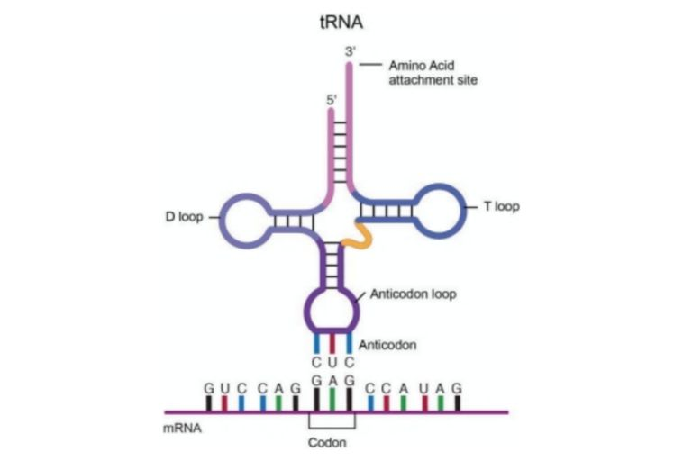
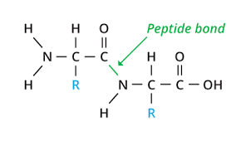
Biopolymers
Proteins
Nucleic acids: DNA, RNA
Chromatin

Slide 7
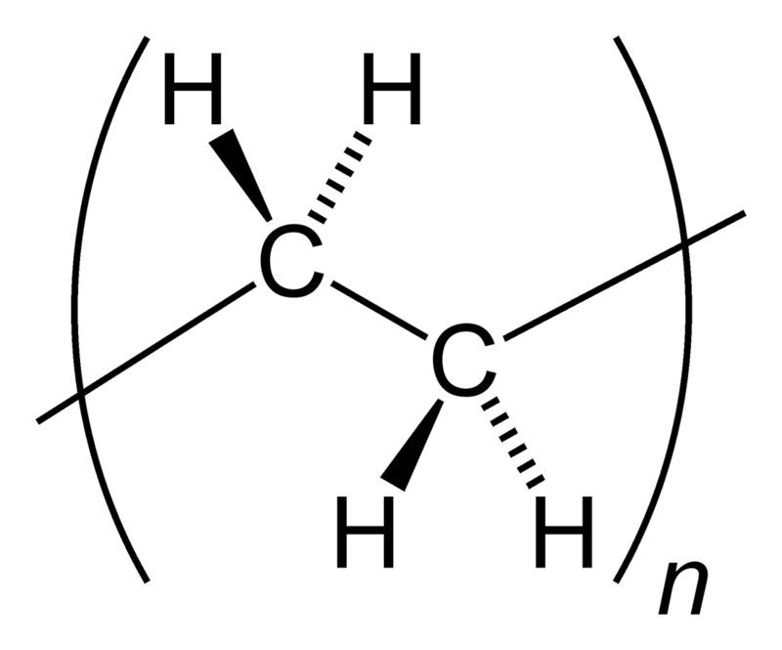
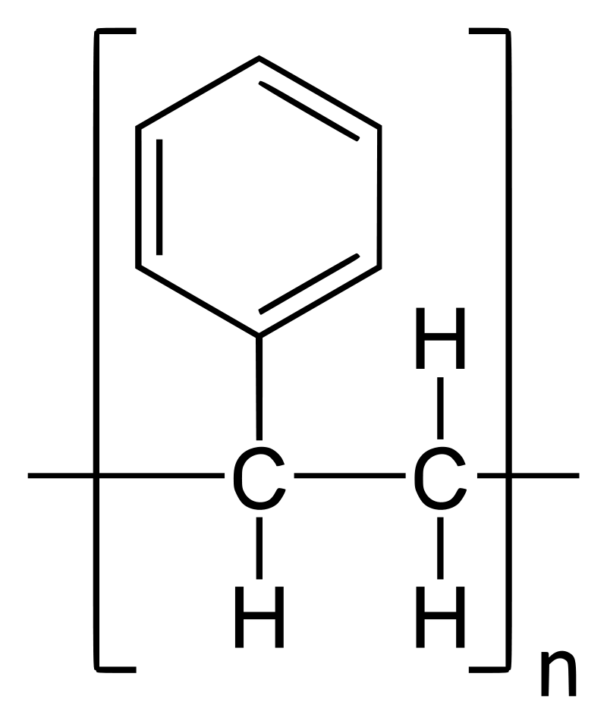
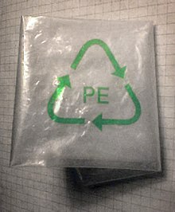
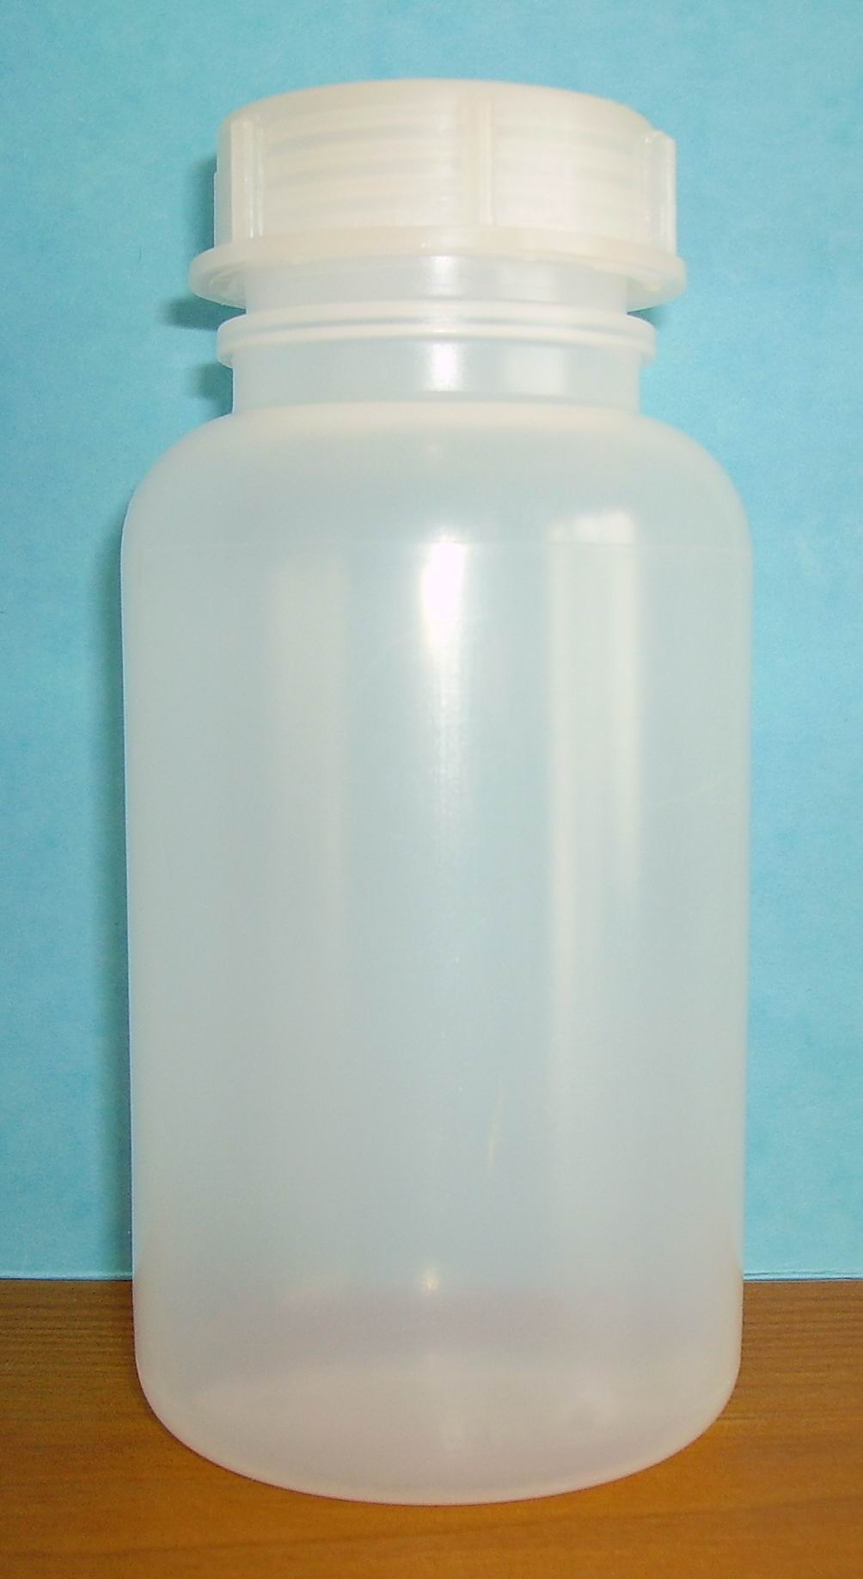
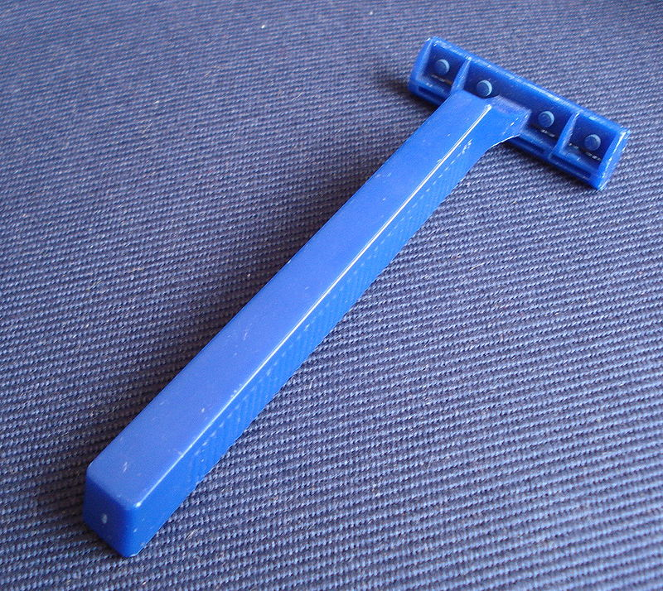
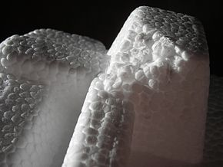
Polymers, main features
a) Chain connectivity
b) Aggregate states / dilution
1. Gas: dilute solutions
2. Liquid: semi-dilute solutions / melts
3. Solid: rubber-elastic networks, polymer glasses, semi-crystalline polymers
Polyethylene
Polystyrene

Slide 8
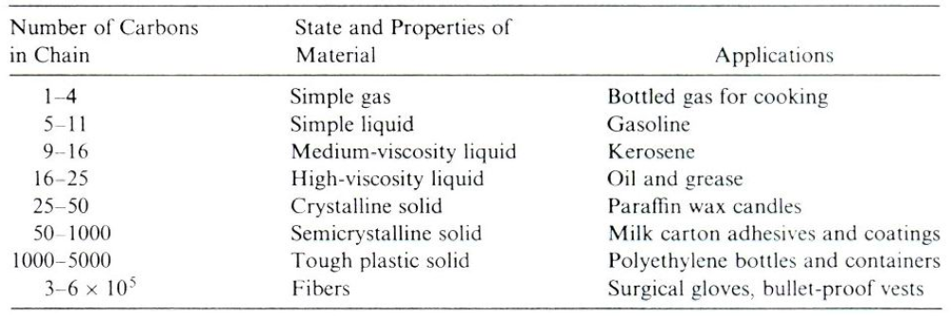
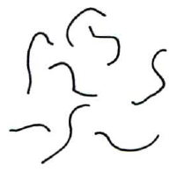
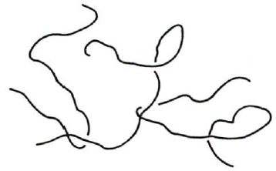
Polymers, main features
c) The effect of chain length, properties of the alkane/PE series:
Solution/melt:
Low molecular weight High molecular weight
No entanglement Yes entanglement

Slide 9
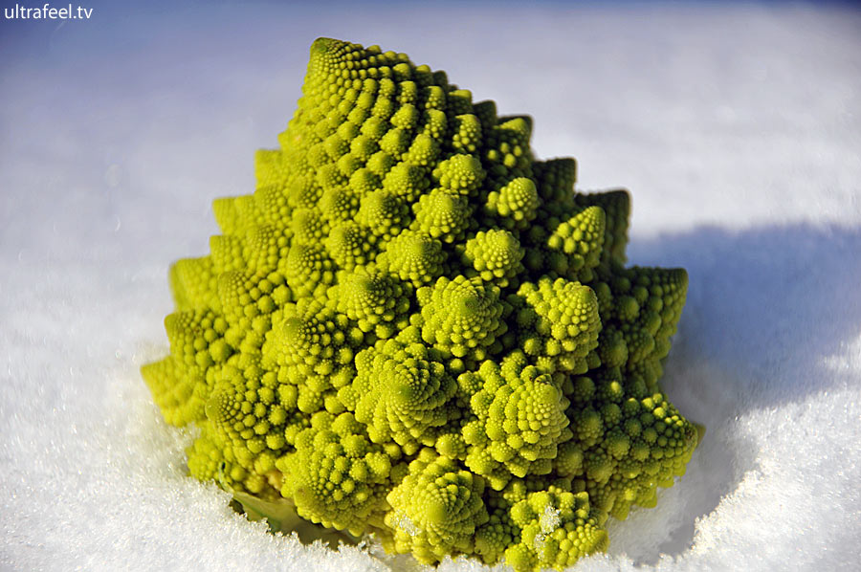
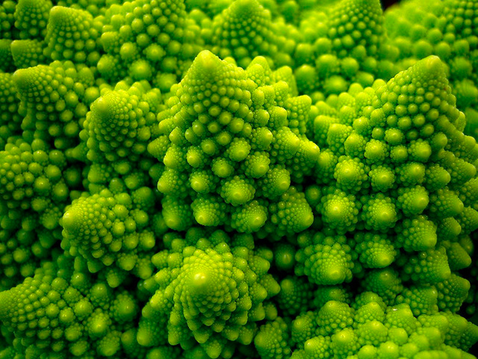
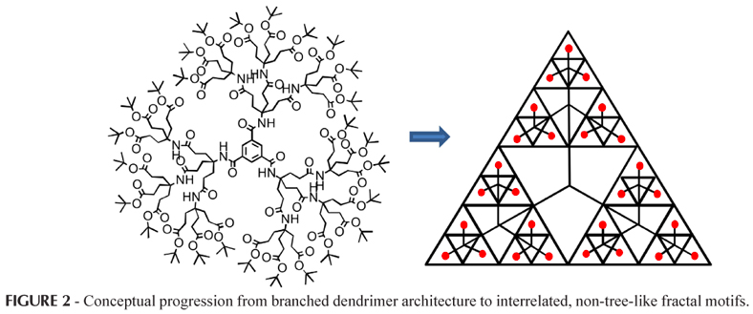
Scale invariance: Polymers are fractal objects

Slide 10
Scale invariance: Polymers are fractal objects

Slide 11
Scale invariance: Polymers are fractal objects

Slide 12
Scale invariance: Polymers are fractal objects
Every sub-chain behaves as the whole chain
Ça va sans dire, corresponding end-to-end distribution functions have also the same functional form (Gaussian, Redner-Des Cloizeaux, …) -> The concept of universality!

Slide 13
Outline
Part I - Introduction to Polymers
Part II - Polymer Physics
Structure
Dynamics
Part III - Simulations methods:
Exact enumeration
Monte Carlo
Molecular Dynamics

Slide 14
Linear polymers

Slide 15
Linear polymers
Bouchaud & Georges
PRB (1989)

Slide 16
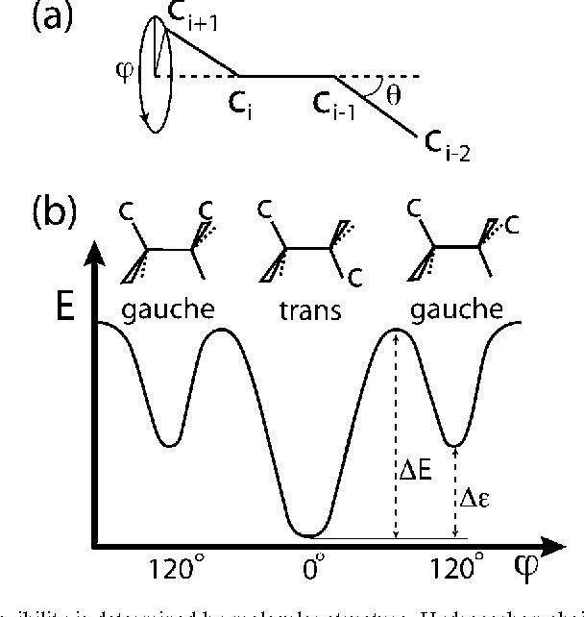
Linear polymers: γ>1, ν=1/2 =>
θ_{i}
Freely-jointed chain: (θ_{i}, φ_{i}) unrestricted
φ_{i}
θ_{i+2}
θ_{i+1}
φ_{i+1}
φ_{i}
θ_{i+1}=θ
Freely-rotating chain: (θ_{i}=θ, φ_{i} unrestricted)
θ_{i}=θ

Slide 17
Linear polymers: γ>1, ν=1/2 =>
θ_{i}
φ_{i}
θ_{i+2}
θ_{i+1}
Kuhn’s model:
φ_{i+1}
φ_{i}
θ_{i+1}=θ
θ_{i}=θ

Slide 18
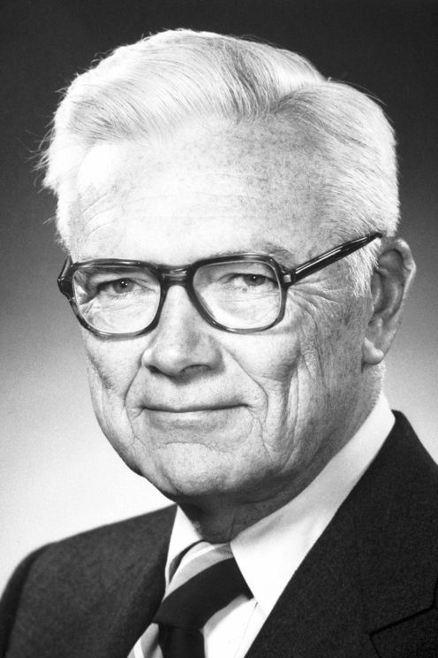
Linear polymers: γ<1, ν=(2-γ)/2 =>
Excluded volume:
Two monomers can not occupy the same position in space!
PJ Flory

Slide 19
Outline
Part I - Introduction to Polymers
Part II - Polymer Physics
Structure
Dynamics
Part III - Simulations methods:
Exact enumeration
Monte Carlo
Molecular Dynamics

Slide 20
Polymers dynamics: The Rouse-Zimm Model
Theoretical foundations: The Brownian motion
Consider a system of `large’, freely diffusing particles (red) in a homogeneous medium composed of smaller particles (blue);
The red particles collide randomly with the blue particles;
Due to random collisions, the motion of red particles is erratic as well
After time τ, red particles have traveled – on average – a distance δr²(τ)

Slide 21
Polymers dynamics: The Rouse-Zimm Model
Polymer chain: the red particles are now linearly connected
How does this affect the time behavior of the mean-square-displacement δr²(τ)?

Slide 22
Polymers dynamics: The Rouse-Zimm Model
Polymer chain: the red particles are now linearly connected
How does this affect the time behavior of the mean-square-displacement δr²(τ)?
Clearly, at very short times, each monomer moves does not “feel” the presence of the other monomers -> δr²(τ) = 6Dτ

Slide 23
Polymers dynamics: The Rouse-Zimm Model
Polymer chain: the red particles are now linearly connected
How does this affect the time behavior of the mean-square-displacement δr²(τ)?
Clearly, at very short times, each monomer moves does not “feel” the presence of the other monomers -> δr²(τ) = 6Dτ
At later times ?? More and more monomers become involved !!

Slide 24
Polymers dynamics: The Rouse-Zimm Model
Linear connectivity + Gaussian fluctuations => elastic springs
“microscopic” time-scale
relaxation of subchains of length “N/p”

Slide 25
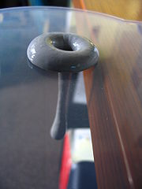
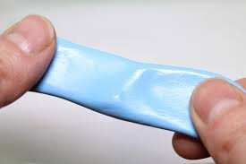
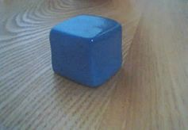

Polymers dynamics: Viscoelasticity
Example: Silly Putty©
Silly Putty© is marketed today as a toy for children, but was originally created by accident during research into potential rubber substitutes for use by the United States in World War II.
Silly Putty©:
bounces;
breaks when given a sharp blow;
can also flow like a liquid.
Silly Putty©'s unusual flow characteristics are due to the ingredient polydimethylsiloxane (PDMS), a viscoelastic liquid.
Viscoelasticity is a type of non-Newtonian flow, characterizing material that acts as a viscous liquid over a long time period but as an elastic solid over a short time period.
Source: Wikipedia

Slide 26
Outline
Part I - Introduction to Polymers
Part II - Polymer Physics
Structure
Dynamics
Part III - Simulations methods:
Exact enumeration
Monte Carlo
Molecular Dynamics

Slide 27
Simulation methods. 1: Exact enumeration
Example: self-avoiding-walks vs. random-walks on the 2d simple cubic lattice
N=3

Slide 28
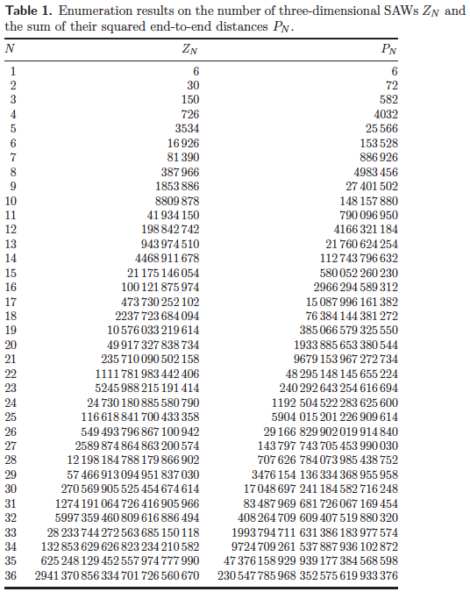
Simulation methods. 1: Exact enumeration
Example: self-avoiding-walks vs. random-walks on the 2d simple cubic lattice
μ: non universal, depends on lattice choice
ν, θ: universal
Schram et al., J Stat Mech (2011) P06019

Slide 29
Simulation methods. 2: Monte Carlo
Problem: Numerical evaluation of π=3.1415926535…
+
+
+
+
+

Slide 30
Simulation methods. 2: Monte Carlo
In practice, MC means to sample the space of configurations with the “correct” probability. In this case, the uniform distribution on the 2d circle:
N_{tot}=100
N_{tot}=1’000
N_{tot}=10’000
N_{tot}=100’000
N_{tot}=1’000’000
N_{tot}=10’000’000
The black line corresponds to the exact expression

Slide 31
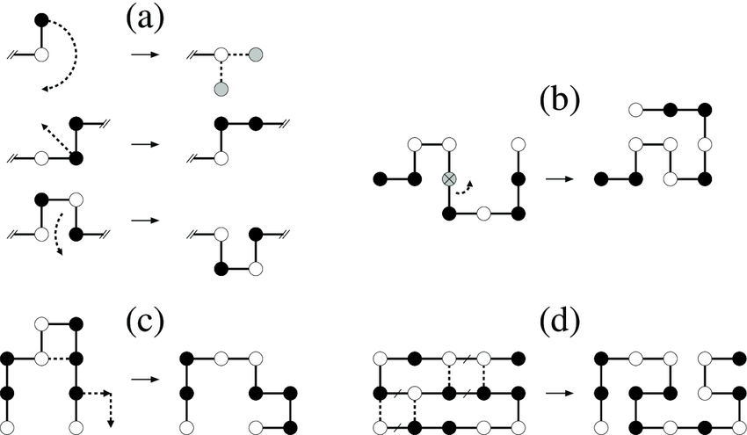
Simulation methods. 2: Monte Carlo
Alan D. Sokal, “Monte Carlo methods for the self-avoiding walk”, http://arxiv.org/abs/hep-lat/9509032

Slide 32
Simulation methods. 3: Molecular Dynamics
Numerical solution of Newton’s equations for a system of N particles (coupled to each other):

Slide 33
Simulation methods. 3: Molecular Dynamics
How to impose:
a) Excluded volume
b) Connectivity
Kremer & Grest, JCP 92 (1990)

Slide 34
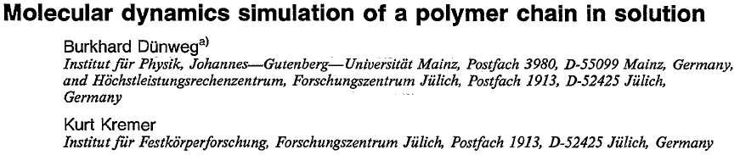
Simulation methods. 3: Molecular Dynamics
Exercise:
Impose linear connectivity to a certain number of monomers (say, 10-20)
Check distances between n.n. monomers (should remain close to σ)
Simulate a single polymer chain WITHOUT and WITH “solvent”
Equilibrate the chain, monitor:
g₁(τ) := single-monomer time mean-square-displacement (msd)
g₂(τ) := single-monomer time msd in the frame of the polymer
g₃(τ) := time msd of the center-of-mass of the polymer
In particular, study single-monomer time msd (g₁(τ)):
WITHOUT => Rouse
WITH => Zimm

